Slide 1
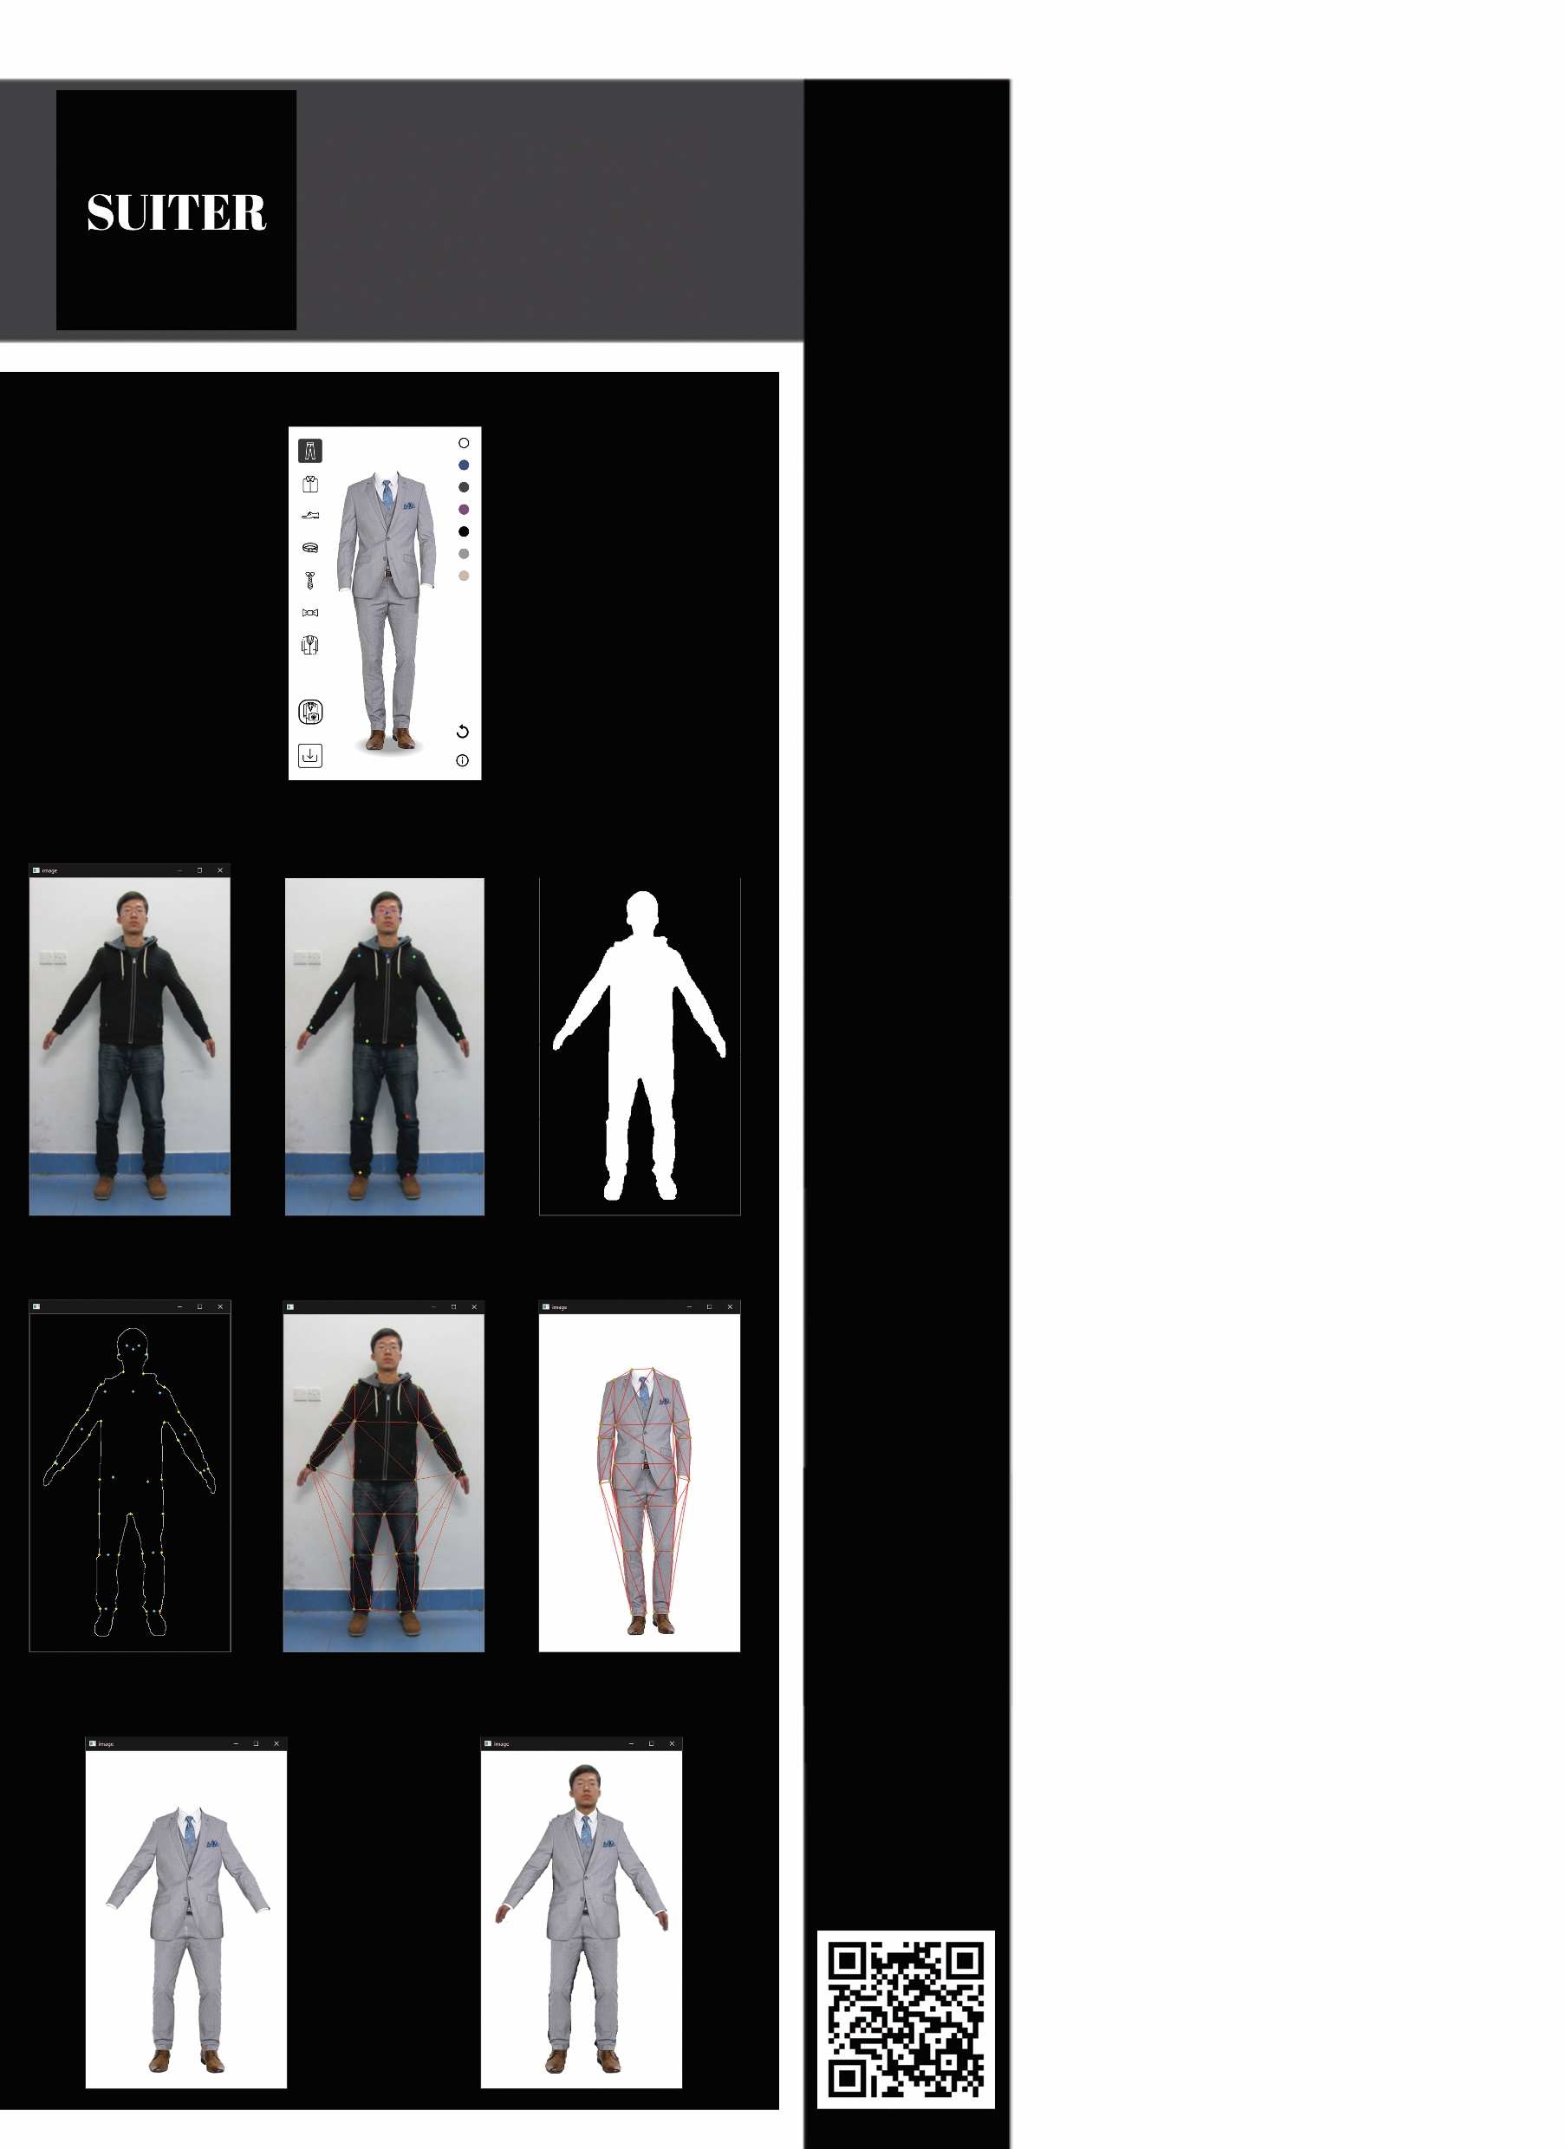
Suiter
01
Contribution/project
goal:
Our goal is to create an app that helps users choose a suit and see how it looks
on them before buying it.
01
Presents: Eli Haimov, Yosi Golubchik
Instructor: Elad Aigner-Horev
(a)
02
05
Introduction:
The Suiter application will allow the user to choose a suit for himself and see how it will look on him. The user will provide a front view photograph of himself
and choose colors for the suit, and the application will draw
the suit on top of him accordingly.
(b)
(c)
(d)
03
Methods/algorithms
/Alternatives or
Design Considerations:
We could have used only deep learning, or only computer vision algorithms without any deep learning.
Alternatives: Go to physical store or shop online and hope it will look good.
Design consideration: Needs to run on smartphones.
(e)
(f)
(g)
04
Selected Approach:
We chose to use both deep learning and computer vision, for different steps of the process.
Deep learning: Pose estimation, MaskRCNN
Computer Vision: Triangulation, Piecewise Affine Transformation, Blending, Grabcut
(h)
(i)
Visit Us

